Slide 1
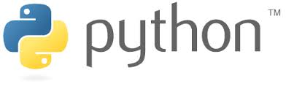
Python Rocks
Introducing the Python programming language to the SMEDG community
By Rupert Osborn
H&S Consultants

Slide 2
Presentation notes
Pages on a blue background are additions to the presentation for those who didn’t attend the talk
They give a summary of the points made in the talk where necessary
The second part of the talk was presented using the IPython Notebook. This should also be available for download from the SMEDG website
The last slide gives advice on how to download Python – use a distribution like Anaconda! http://continuum.io/downloads

Slide 3
What is Python?
Python is a general purpose, high-level, object oriented, programming language
Free and open-source
Readable and intuitive

Slide 4
What is Python?
Python is an easy to use programming language
Many geologists feel intimidated by programming languages
Programming languages can help the exploration geologist by automating repetitive tasks and enable quicker, deeper data analysis

Slide 5
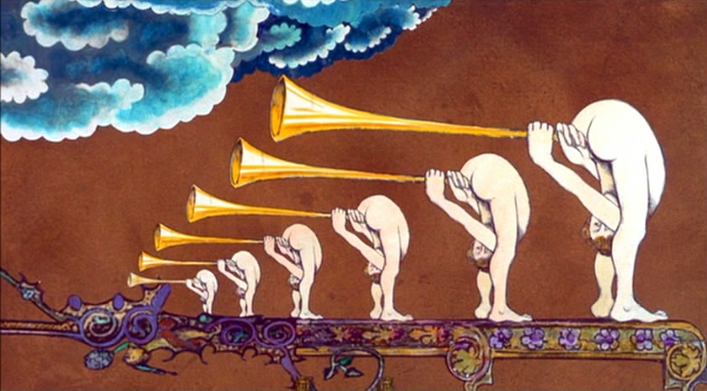
History of Python
Started in 1989 by Guido van Rossum
Named after Monty Python’s Flying Circus

Slide 6
History of Releases
Python 1.0 released in 1994
Python 2.0 released in 2000
Python 3.0 released in 2008
Python 2.7 is currently the recommended version???
Python 3 is the future of the language
Micromine uses Python 3.3 (so that’s what I use)

Slide 7
Why Use Python?
Fast to write
Easy to read
Continually developing – Thriving ecosystem of third-party libraries
Huge number of simple and advanced functions
Loads of examples and help online
Great IDEs (integrated development environments)
Multi-platform (Windows, Apple, Linux, etc)

Slide 8
Why Use Python?
Reads like English
Third-party libraries (e.g. NumPy) add huge functionality and are growing
Was considered as the glue between languages but is quickly becoming the Swiss army knife
Basically, IDEs are the interface that you type into. The ones available free for Python are great. They mark up mistakes (syntax errors) and include tab completion which is a bit like predictive text

Slide 9
Languages used at CSIRO
Python | Fortran | Java
Matlab | C | VB.net
IDL | C++ | R
Perl | C# | + 5-10 others
Source: Python Charmers presentation
Different language for each task?

Slide 10
Languages used at CSIRO
Python is developing to be able to do all the tasks done by a large selection of specialist languages
Python has improved massively over the last five years because more and more people are enjoying the ease of use and therefore more people are putting an effort into producing more functions and third-party libraries

Slide 11
Computing Speed for $
Year | Approximate cost per GFLOPS (US$) | Platform providing the lowest cost per GFLOPS
1961 | $1,100,000,000,000 | About 17 million IBM 1620 units costing $64,000 each
1984 | $18,750,000 | Cray X-MP/48
1997 | $30,000 | Beowulf clusters with Pentium Pro microprocessors
2000 | $1,000 | Bunyip Beowulf cluster
2003 | $82 | KASY0
2007 | $48 | Microwulf
2011 | $1.80 | HPU4Science
2013 | $0.22 | Sony PlayStation 4
2015 | $0.08 | Celeron G1830 R9 295x2 System

Slide 12
Computing Speed for $
GFLOPS means Giga Floating point Operations per Second
Fortran was designed when programmer’s time was cheaper than processing time
Fortran and C are 10x slower to write than Python (and that is not including the use of ready made functions available in Python’s third-party libraries)
The computer takes longer to process Python scripts but optimised libraries like NumPy make it much quicker (similar to C++)

Slide 13
Python Successes
United Space Agency - NASA
Google: Maps, Gmail, Groups, News
YouTube, Reddit, BitTorrent
Civilisation IV
Financial analysis
Research: Universities worldwide for a variety of disciplines

Slide 14
Python Successes
Because Python is easy and quick to read and write, and because it is so versatile, people are using it more and more for a variety of applications

Slide 15
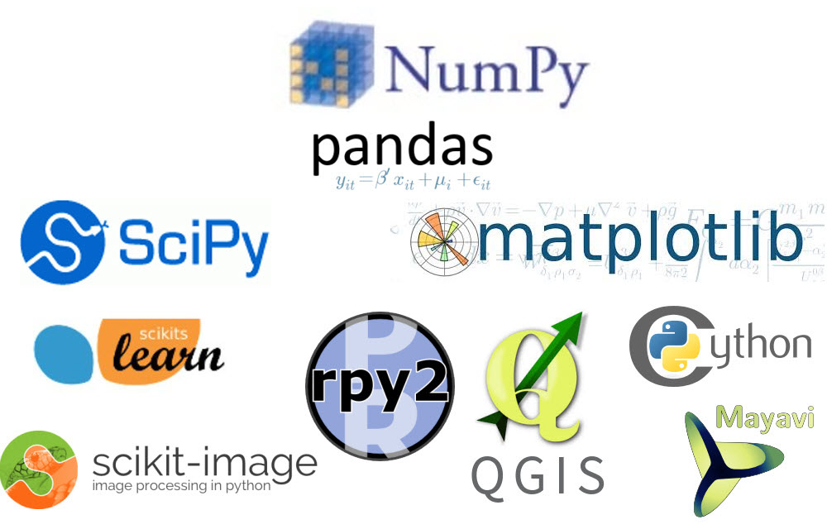
Python Libraries For Scientific Computing

Slide 16
Python Libraries For Scientific Computing
So far I have tried to explain why Python is a good choice of languages to learn
But how will a programming language benefit geologists?
Python has a load of third-party libraries, some of which are shown on the slide
Specialist geological libraries are lacking but there are a few geophysical and hydrogeological libraries available or in development

Slide 17
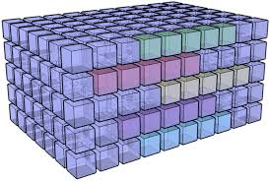
NumPy: Numerical Python
NumPy is the fundamental package for scientific computing with Python. It adds a fast and sophisticated array facility to the Python language

Slide 18
NumPy
The NumPy library forms the basis of Python’s scientific computing ability
It includes routines for mathematical, logical, shape manipulation, sorting, selecting, discrete Fourier transforms, basic linear algebra, basic statistical operations, random simulation and much more
Python uses loops to iterate over data. This is slow because it needs to convert commands to machine code and execute them one by one
NumPy is built to operate efficiently on arrays of numbers by sending batches of data to optimized C and Fortran code
The first part of the IPython Notebook that accompanies this presentation explains a little more about why NumPy is so useful

Slide 19
Pandas
DataFrame object for data manipulation with integrated indexing
Label-based slicing, fancy indexing, and subsetting of large data sets
Tools for reading and writing data to different file formats
Basic but handy quick plotting
Group by engine allowing split-apply-combine operations on data sets
Reshaping and pivoting of data sets
Time series-functionality, merging and joining, integrated handling of missing data, Data structure column insertion and deletion, Hierarchical axis indexing to work with high-dimensional data in a lower-dimensional data structure

Slide 20
Pandas
Pandas uses a DataFrame object which can be thought of as a table of data (although it can be more complicated)
It was built by the finance sector to aid with data manipulation and data analysis
It has loads of brilliant functions to really dig into your data
It has useful functions for reading and writing to file types such as csv and Excel

Slide 21
Matplotlib
Plotting library for graphs
Designed to closely resemble MATLAB
Simple to publication quality graphs
Great gallery with examples
Plenty of tutorials and help (Stack Overflow)

Slide 22
Matplotlib
Matplotlib is now the recommended plotting library to make graphs etc.
The Matplotlib figures can be easily customised and produce publication quality plots
Using the Matplotlib, NumPy and Pandas libraries together make data analysis much easier and reproducible than in Excel

Slide 23
SciPy: Scientific Python
Gathers a variety of high level science and engineering modules together:
stats: statistical functions
spatial: KD-trees, nearest neighbors, distance functions
interpolate: interpolation tools e.g. IDW, RBF
ndimage: various functions for multi-dimensional image processing
optimize: optimization algorithms including linear programming
constants: physical constants and conversion factors
fftpack: Discrete Fourier Transform algorithms
integrate: numerical integration routines
linalg: linear algebra routines
misc: miscellaneous utilities (e.g. image reading/writing)
signal: signal processing tools
special: special functions

Slide 24
SciPy: Scientific Python
The SciPy library has loads of more advanced functions – enabling, for example, high-level statistical functions to be called using a single line of code

Slide 25
Scikits: SciPy Toolkits
scikit-learn: various classification, regression and clustering algorithms including support vector machines, random forests, gradient boosting, k-means and DBSCAN
scikit-image: algorithms for segmentation, geometric transformations, colour space manipulation, analysis, filtering, morphology, feature detection, and more.

Slide 26
Scikits: SciPy Toolkits
Scikits offer a few more specialised libraries e.g. Scikits-Learn which provides a load of machine learning capabilities. Supervised and unsupervised classification processes are available
The accompanying IPython Notebook shows how easy it is to conduct dimensionality reduction (Factor Analysis) and unsupervised classification (k-means clustering) on ICP data to help differentiate rock types

Slide 27
IDE (Integrated Development Environment)
IDEs are basically the interface into which you type the code
Great packages like Spyder, PyCharm and the Ipython Notebook
Auto-complete and tab-complete options
Syntax and spelling errors are highlighted automatically

Slide 28
Download and Install
There are a couple of Python distributions that are easy to download and install
These include the most popular Python libraries
Anaconda is recommended for science, math, engineering, data analysis.
The link will only work if viewing this presentation in Slide Show. Alternatively just search for “Download Anaconda”

Slide 29
Ipython Notebook Example
For those at the presentation we’re going to go through the IPython Notebook part of the presentation
A version of this will be available for download but unfortunately I won’t be able to provide the data with it
Install Anaconda then you can try it with your own data

